Slide 1

St. Louis Region’s World Class Logistics Hub New Option to Transport Freight:
Container on Vessel and Container on Barge
Mary Lamie, P.E.
Executive Vice President – Multi Modal Enterprises
Bi-State Development

Slide 2
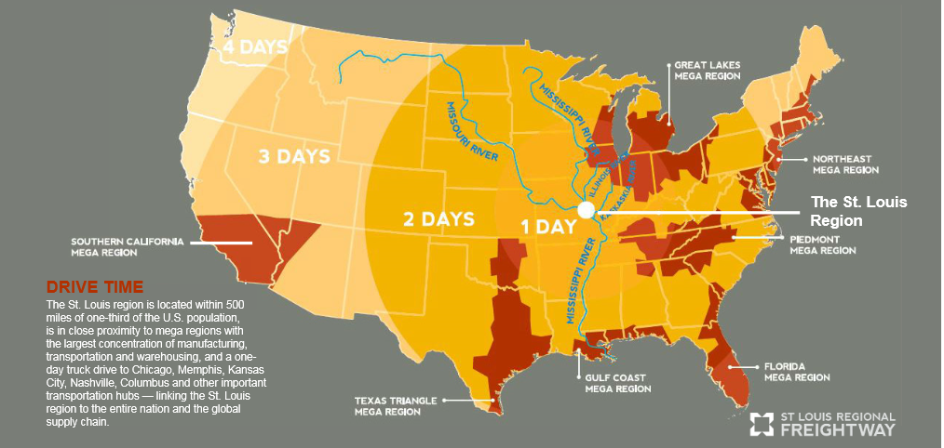
Why the St. Louis Region?
Epicenter of the Midwest!

Slide 3
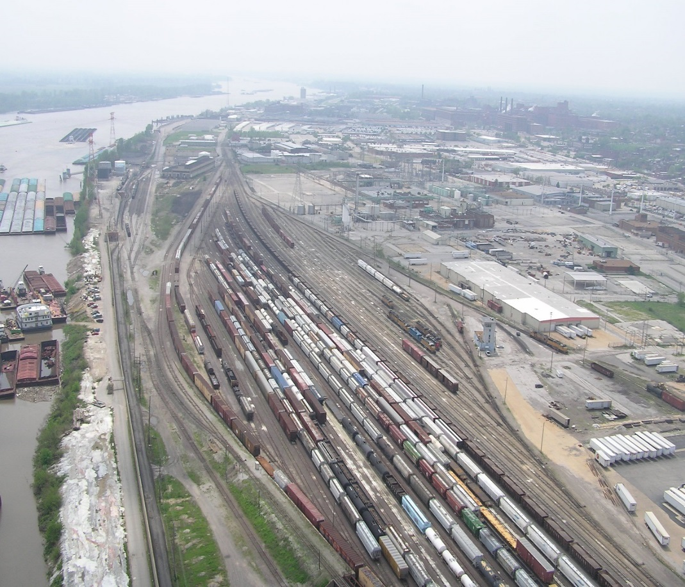
Why the St. Louis Region?
St. Louis Region’s Competitive Advantages
Geographic advantage
  Central location in the country
  Strategic location on the Mississippi River
  Northernmost ice-free & lock-free access on the Mississippi River to and from the Gulf of Mexico
Six Class I Railroads - Intermodal Connectivity
  The nation’s 3rd largest rail hub offering national railroads with reach, using a single switching carrier – Terminal Railroad Association of St. Louis (TRRA). BNSF, CN, CSX, KCS, NS and UP
  Bi-state region has 4 intermodal rail yards
Notes:
Lamie

Slide 4
Why the St. Louis Region?
St. Louis Region’s Competitive Advantages
Interstates Provide National Access
  I-44, 55, 64 and 70
  Interstate system is toll-free and has significantly lower congestion than other similar size U.S. urban areas
  One-day drive or less to major cities such as Chicago, Memphis, Nashville, Kansas City and Columbus
Two International Cargo Airports
  St. Louis Lambert International Airport and MidAmerica St. Louis Airport – Both have rail access capabilities, foreign trade zones and available land for development.

Slide 5
Why the St. Louis Region?
St. Louis Region’s Competitive Advantages
America’s most efficient inland port and 2nd largest inland port
  St. Louis region’s barge industry handled 500,000 tons per mile. It’s closest competitors, the Port of Huntington – Tri-state in West Virginia and Ports of Cincinnati – Northern Kentucky, ranked second and third respectively.
  The St. Louis Region’s ports and river terminals captured one-third of all freight traffic along the section of the Mississippi River from Minneapolis, Minn., to the Ohio River near Cairo, IL. The 70-mile St. Louis regional port system represents 8 percent of this 855 –mile section of the river, yet carried one-third of the total freight.

Slide 6
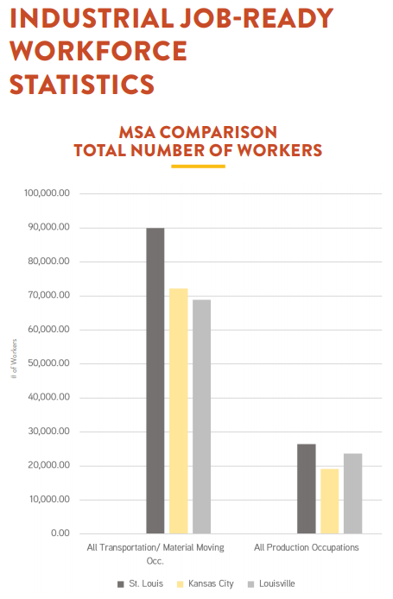
Why the St. Louis Region?
Largest number of workers employed in manufacturing among comparatively sized Midwestern cities
Notes:
Mike McCarthy

Slide 7
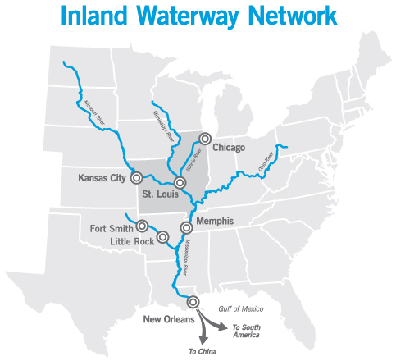
Why the St. Louis Region?
The Mississippi River from St. Louis to the Gulf of Mexico is one of the most significant export logistics systems in the nation.
The Asian American Chamber of Commerce of St. Louis provides connections from our region to the Asian community and businesses.
Notes:
Mike McCarthy

Slide 8
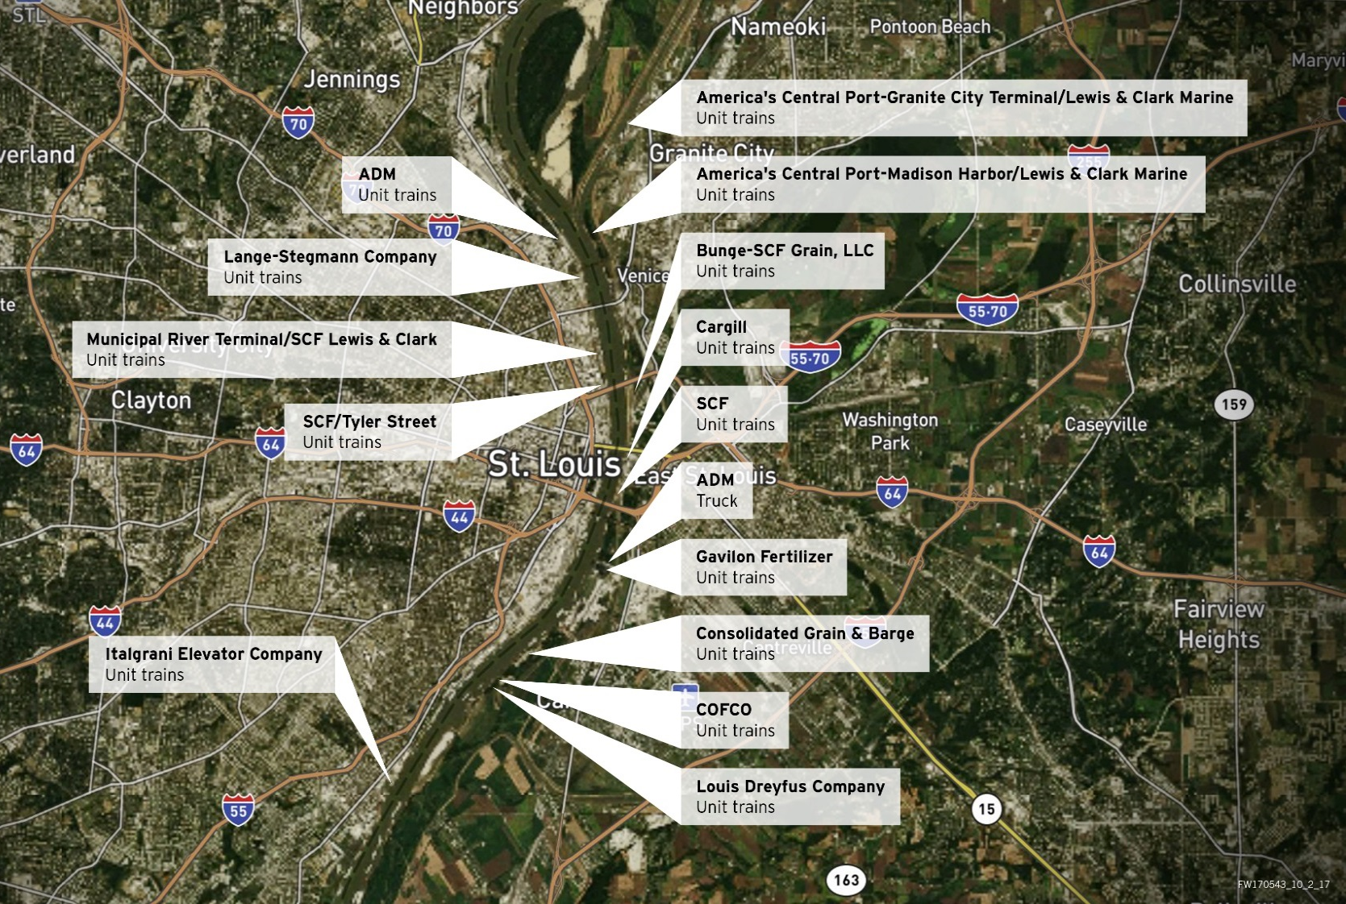
Why the St. Louis Region?
Ag Coast of America
Why is this region called the
Ag Coast of America?
Capacity: St. Louis has the highest level of barge handling capacity ANYWHERE along the Mississippi River!
15 barge transfer facilities within a 15-mile section of the Mississippi handling agricultural and fertilizer products
Shippers have multimodal optionality
Result of growing demand for agricultural exports, as well as cost-effective and efficient transfer facilities
Notes:
Mary Lamie

Slide 9



Why the St. Louis Region?
Ag Coast of America
The St. Louis region is leading the world in addressing global food security concerns
Transportation: Most efficient inland port in the nation and 2nd largest inland port
Production: 50% of U.S. crops and livestock are produced within a 500-mile radius of the St. Louis region, including approximately 80% of corn and soybean acreage
Agricultural Technology: International leader in Agtech - Attracted more than 1,000 Ph.D. plant scientists – the highest concentration anywhere in the world
Notes:
Mike – Private industries are gaining a better understanding of funding opportunities with an emphasis on freight grants. CRISSI, BUILD, etc..

Slide 10
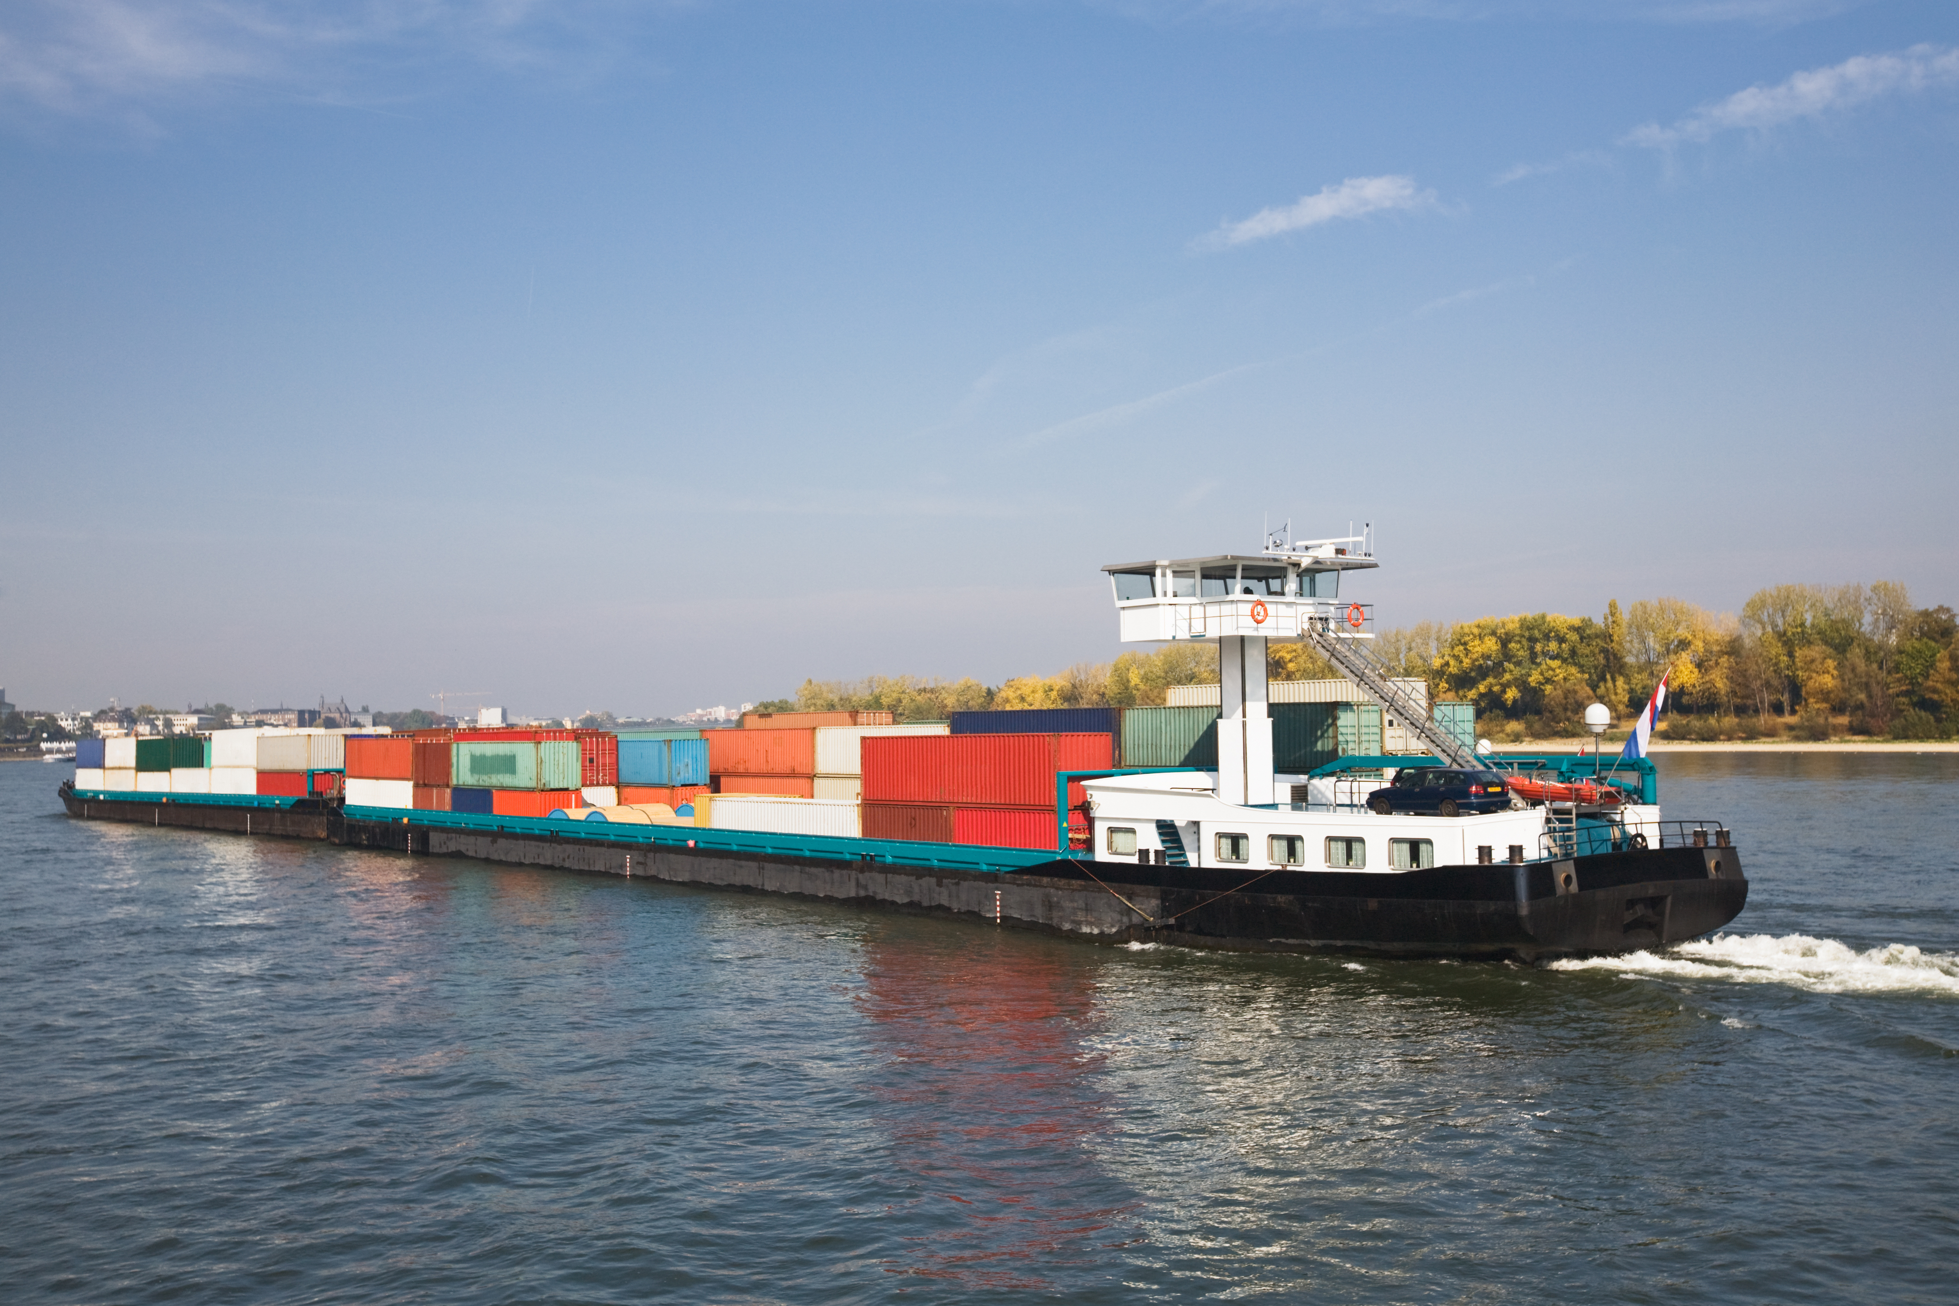
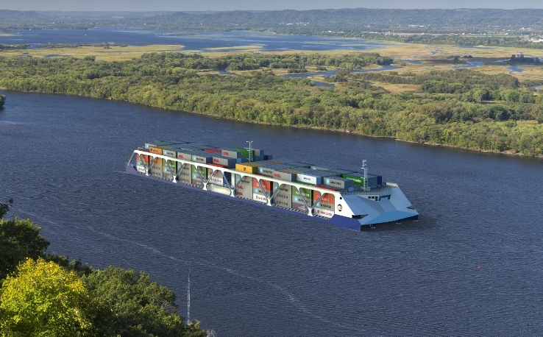
What is this project about?
New Mode of Transportation for Containerized Cargo
Container on Barge
Container on Vessel

Slide 11
What is this project about?
New Mode of Transportation for Containerized Cargo
Project Scope: The St. Louis region is partnering with the Port of Plaquemines located in southern Louisiana to develop a hub and spoke transportation and logistics system. Shippers could potentially save up to 30% versus other intermodal alternative using an all-water route connecting ports in the St. Louis region and other ports in the Midwest to the lower Mississippi River and ultimately to Asia, Europe and other foreign ports. Transportation time is anticipated to be comparable to other modes of transportation.
Plans to transport freight via innovative waterway vessels will revolutionize the inland waterway system and provide significant transportation cost saving for shippers, especially those accessing the Midwest by utilizing the Mississippi River.

Slide 12
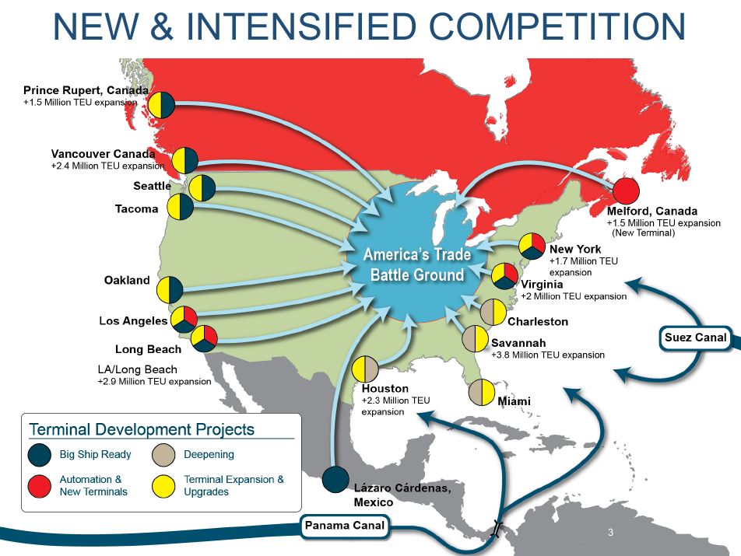
What is this project about?
New Mode of Transportation for Containerized Cargo
Midwest Battleground

Slide 13
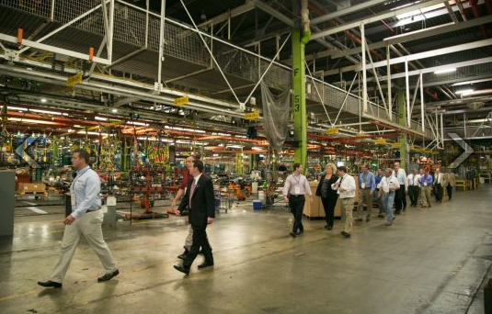
Containerized Cargo Commodities – Missouri and Illinois
IMPORTS
  Household goods
  Raw materials
  Automotive parts
  Finished materials
  Seasonal furniture, appliance, ceramic title
EXPORTS
  Agriculture – soybeans and rice
  Refrigerated cargo
  Consolidated cargo
  Finished products
  Tires, wood veneer, beef, pork

Slide 14



Route Transit Times: All Water vs. Ocean-Rail
NORTH AMERICA
EUROPE
ASIA
Los Angeles
St. Louis Region
All Water Route*
Ocean – Rail Route
All Water Route*
ATLANTIC OCEAN
AFRICA
All Water Route*
SOUTH AMERICA
AUSTRALIA
PACIFIC OCEAN
* All Water Route transit time is comparable to Ocean-Rail Route transit time.
Notes:
Add arrow from north end of South America and merge to the arrow leading into Port of Plaquemines

Slide 15
Container on Vessel/Barge: Value
U.S. Department of Transportation anticipates a 40% increase in freight volume over the next three years based on a 60 % increase in the U.S.’s population by 2050 and growth in global population toward 9 billion people over the same period.
Global container market growth is predicted to grow from roughly 800 million twenty-foot equivalent unit (TEU) containers in 2018 to more than 1 billion by 2025. This growth will significantly increase the volume of containerized cargo and truck freight that must move throughout the U.S. and China, creating unique opportunities.
Larger ocean carrier vessels are causing more congestion at West Coast Ports

Slide 16
Container on Vessel/Barge: Value
The St. Louis region is helping develop a container on vessel service that will provide greater fuel efficiency and a reduction in the cost of freight movement.
Benefits:
  Most cost effective transportation route for freight movement
  Reduces air emissions by reducing trucks on roadway
  Maintain and enhance competitiveness for both the U.S. and China, and improve the global supply chain.

Slide 17
Container on Vessel/Barge: Cost
Estimated Project Cost approaches $1 billion.*
  Estimated cost for proposed Jefferson County Port, MO is $200 mil
  Estimated cost for Port of Plaquemines mega port-terminal exceeds $700 mil
  Fabrication of the container on vessels not included
  *Cost do include sister ports – Jefferson City, MO, Kansas City Port Authority and others
Job Creation: USDOT - $1 billion invested in transportation infrastructure creates over 21,000 jobs. Every dollar invested in transportation infrastructure returns $3.54 in economic impact.

Slide 18
Container on Vessel/Barge: Project Delivery
Jefferson County Port, Missouri – This Port will be privately owned and operated. Jefferson County Port Authority is helping lead a Container on Vessel port project and is conducting a feasibility plan for two proposed locations. The estimated $200 mil construction cost is not funded. Design and construction will likely take two to three years. Local, state and federal permits will be required. Complexity of the permits will be dependent on project scope. Rail access is anticipated for either location. A privately owned port terminal, Fred Weber, in Herculaneum, MO indicates a temporary port access point for container on vessel could be developed in one year. Cost for these improvements are approximately $1 million. Rail access is anticipated for either location.
America’s Central Port in Granite City, IL – This port is publicly owned and has the infrastructure and equipment to support a container on barge service. They also have rail access and are located in close proximity of the interstate system.
Port of Plaquemines, LA – This is an existing publicly owned port. Estimated construction cost for a mega port terminal is $700+ and is not funded. Design and construction will likely take two to three years. Local, state and federal permits will be required. Complexity of the permits will be dependent on project scope. This location is also railed served and will have air cargo capabilities.

Slide 19
Container on Vessel/Barge: Project Delivery
MOU
Plaquemines PHTD with STL region, KC, Jefferson City, Memphis, Cairo (IL), Western Arkansas (Fort Smith), Little Rock, and Joliet (IL)
IL and MO Ports of call form statewide partnership.
Align manufacturers with container on vessel service
Construction begins for vessels
2017
2018
2019
2020/2021
2022
MOU
STL region
and
Port of New Orleans
Soybean Export Study
APH/Louisiana Gateway
Terminal final negotiations
w/ Ocean Carrier and
International Terminal Operator
Container on Vessel operations begin

Slide 20
Potential Partnerships with China
Gain a greater understanding of goods moved by mode to consolidate freight movements
Support container on vessel/barge services
Form public-private partnerships that support multimodal infrastructure investment. Discuss funding strategies for $200 mil Jefferson County, MO port terminal and $700 mil+ for the Port of Plaquemines’ mega-port terminal
The St. Louis region and the Port of Plaquemines are interested in forming partnerships with Chinese shippers and carriers. An example includes China Oil and Foodstuffs Corporation(COFCO) – one of China’s largest food processor, manufacturer and trader. Three years ago COFCO purchased the first inland port terminal in Cahokia, IL - across from downtown St. Louis.

Slide 21
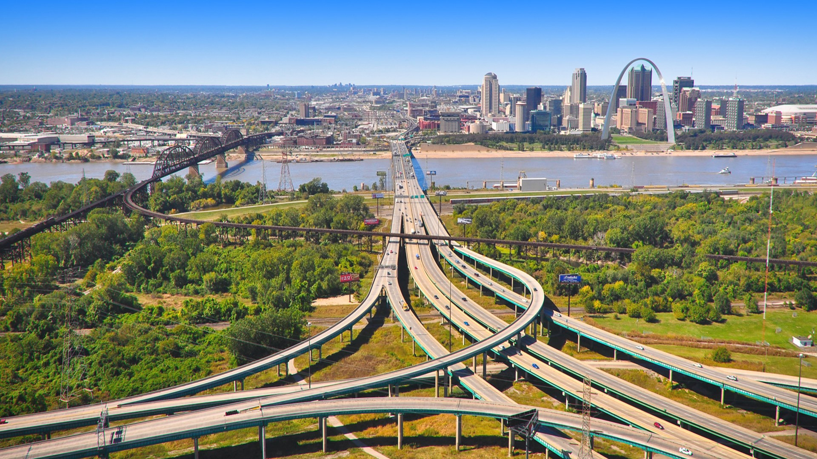
Why the St. Louis Region?
A container on vessel/barge service offers one of the nation’s greatest opportunities to improve transportation efficiency and cost while increasing environmental sustainability. We are not aware of another option that offers comparable impacts.
Photo courtesy of America’s Central Port

Slide 22

Thank you!

